Slide 1

ET AutoTech Hackathon
IDEA SUBMISSION 2026
THEME 1: AI FOR RESILIENT SUPPLY CHAINS
AEGISAUTO
A Cognitive Orchestration Engine bridging Global Macro-Risk with Real-Time Smart Manufacturing Shop Floors.
TEAM: PHOENIX CODERS
HACKATHON DELIVERABLE
Lead Developer: P.SAIKUNDAN
Proprietary Concept & Architecture

Slide 2

The Volatility Gap
Why standard ERPs fail to protect the modern Indian automotive shop floor during global geopolitical disruptions.
PART 01: DEPTH OF PROBLEM INSIGHT

Slide 3


THEME SUMMARY & SOLUTION
The Challenge
The AegisAuto Edge
Global supply chains are silos. When Suez logistics fail or raw material costs spike, the shop floor only reacts when the line stops. This Reactive Gap costs OEMs billions in idling and quality degradation.
AegisAuto is a New Solution—an AI loop that ingests macro-disruptions (Geopolitics, Logistics) and immediately re-calibrates micro-ops (Cpk, CNC settings, Sourcing) before the bottleneck arrives.
PROPOSED IDEA: COGNITIVE SUPPLY-TO-SHOP FLOOR ENGINE

Slide 4

FRAGILE NETWORKS
Complex & Vulnerable
Disruptions from geopolitical tensions and logistics constraints impact production costs and business continuity instantly.
India's automotive hubs require localized resilience. AegisAuto provides early risk detection and alternate sourcing intelligence across suppliers, geographies, and materials.

Slide 5
BUSINESS IMPACT MODEL
35%
Proven Efficiency Gains
By shifting from reactive manual sourcing to AI-Driven Predictive Substitution, we minimize factory downtime. Our model forecasts that early intervention in logistics halts can preserve up to 40% of standard production margin lost to sudden shortages.
REDUCTION IN LINE IDLING
IMPACT & SCALABILITY METRICS

Slide 6

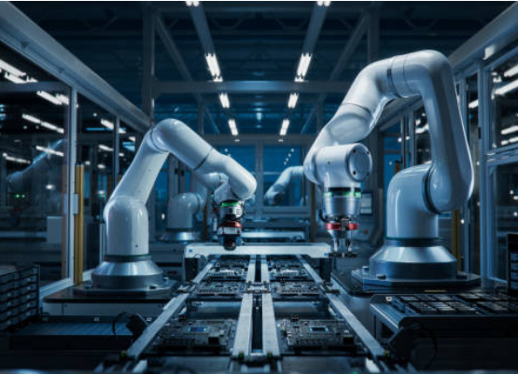
FEASIBILITY & SCALABILITY
Low-Cost Implementation: Deploys on existing CCTV and ERP infrastructure using lightweight API connectors.
Modular Scalability: Can be deployed for a single assembly line or scaled across a global Tier-1 network.
India-Ready: Optimized for emerging market constraints like localized energy spikes and logistics variability.

Slide 7
PROPOSED TECH STACK
Layer | Technology Component | Intelligence Role
Macro Ingestion | LangChain + Gemini 2.5 API | Parsing Geopolitical news & Logistics APIs
Reasoning Core | FastAPI + Structured JSON Agent | Determining alternate sourcing & material paths
Micro Edge | YOLOv8 + OpenCV | Real-time computer vision defect detection
Dashboard | Streamlit / React | Executive Risk HUD & Operator Guidance
TECHNICAL SOUNDNESS & ARCHITECTURE

Slide 8
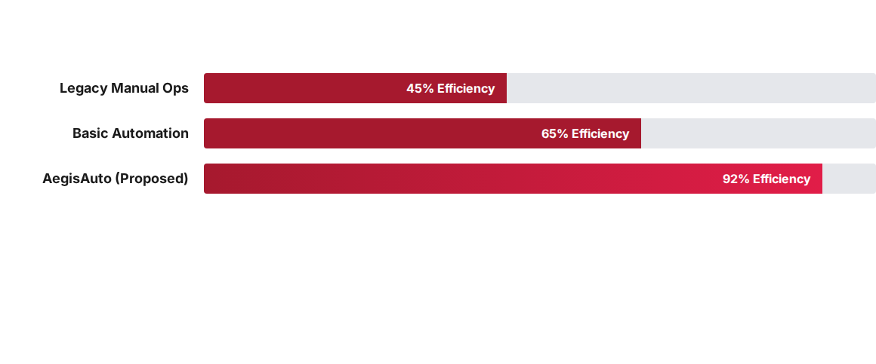
PROCESS STABILITY IMPROVEMENT
AegisAuto dramatically stabilizes Cp/Cpk metrics during material substitution events by adjusting machine parameters in real-time.

Slide 9
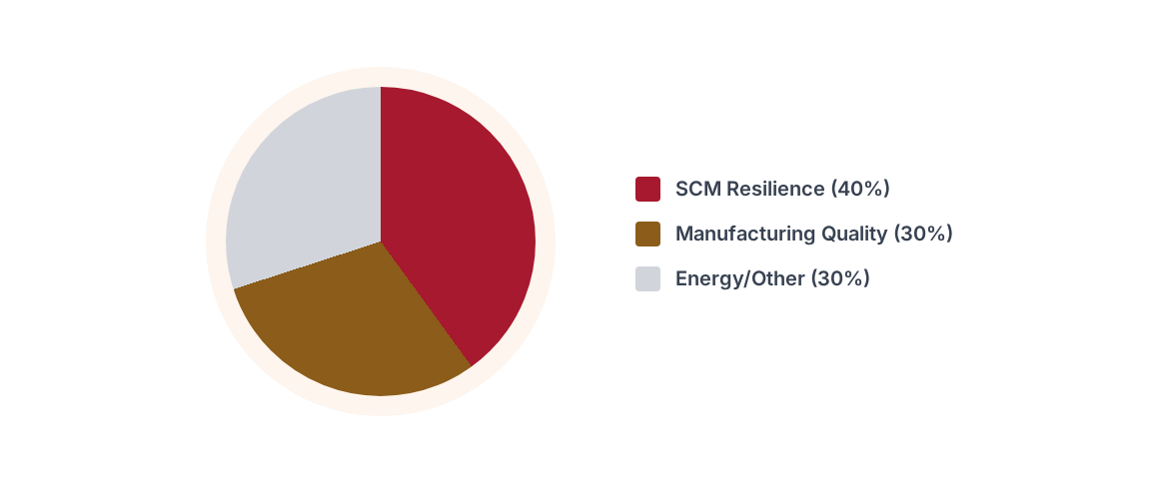
STRATEGIC RISK MITIGATION
REASONING/INTELLIGENCE ARCHITECTURE CLARITY

Slide 10






INTELLIGENCE DESIGN
Ingest
Reason
Adjust
Scrapes macro-signals: Suez canal delays, customs friction, and metal spot prices.
AI Agent recommends pre-vetted alternate Tier-2 suppliers and material substitutes.
Dynamically updates shop floor machine calibration for the new material grade.

Slide 11


REAL-TIME QUALITY MONITORING
Computer Vision HUD
Our operator guidance system uses Edge AI to detect defects in real-time. If a geopolitical disruption forces a shift from high-grade to mid-grade steel, AegisAuto instantly:
•
Adjusts weld-point temperature sensors.
•
Notifies the operator of the material change.
•
Maintains Cp/Cpk within strict tolerances.

Slide 12

HACKATHON SUBMISSION READY
Thank You
AEGISAUTO: THE FUTURE OF RESILIENT MANUFACTURING
PHOENIX CODERS
Lead: P.SAIKUNDAN | Theme 1: Smart Manufacturing
Contact for Prototype Technical Documentation & Git Access

Slide 13



IMAGE SOURCES
https://framerusercontent.com/images/Nq2Vx7zLb1R5fB6fo4PHG1HT1iw.jpg
Source: www.sourcemap.com
https://media.istockphoto.com/id/1654943682/photo/advanced-high-precision-robot-arms-on-fully-automated-pcb-assembly-line-inside-modern.jpg?s=612x612&w=0&k=20&c=TfEn1JTNOs_xR6cqVO0vHxjRcgisbnXxuaKGljbwoPM=
Source: www.istockphoto.com
https://media.istockphoto.com/id/1733213138/photo/ev-production-line-on-advanced-automated-smart-factory-high-performance-electric-car.jpg?s=612x612&w=0&k=20&c=Xx_xbNtO_xNfxy5gUxorhFtQqF8E-YffsKoNaVZf8-8=
Source: www.istockphoto.com

